Slide 1
Inverse Design of Optimal Airfoil Geometries

Slide 2
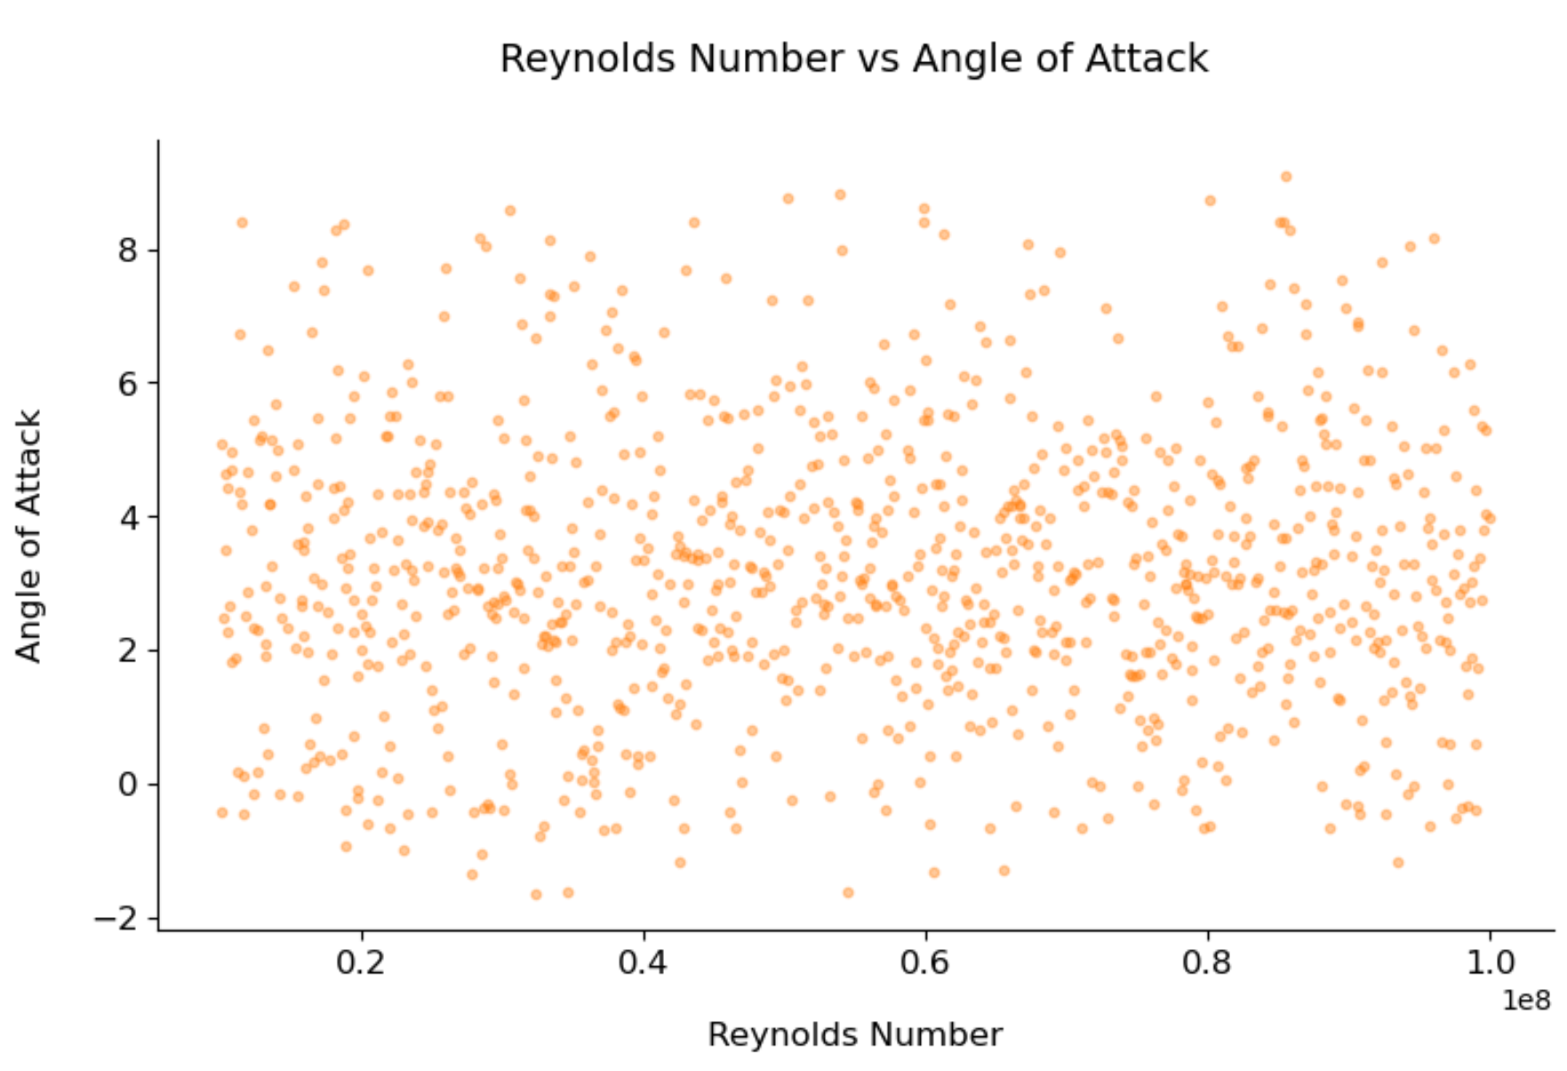
Data Visualization

Slide 3
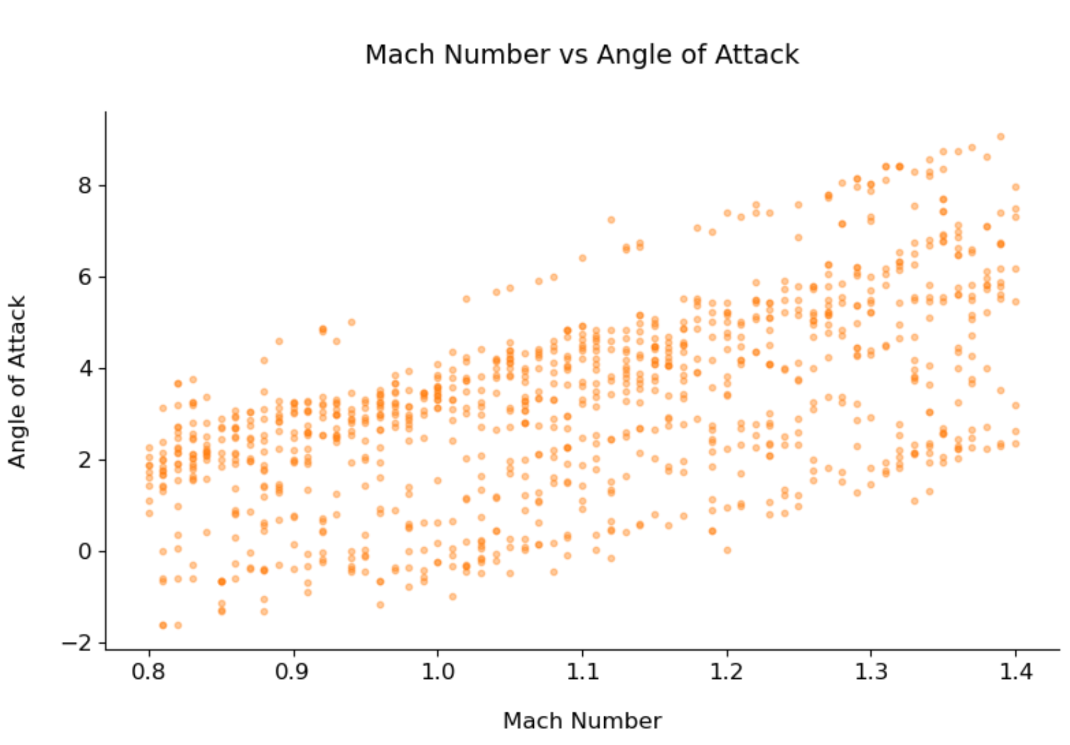
Data Visualization

Slide 4
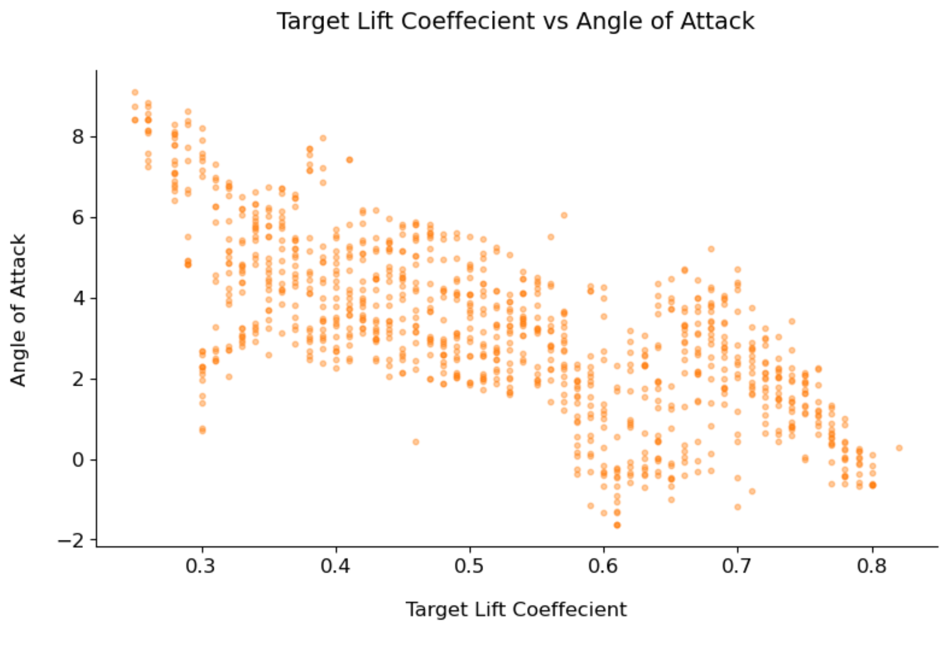
Data Visualization

Slide 5
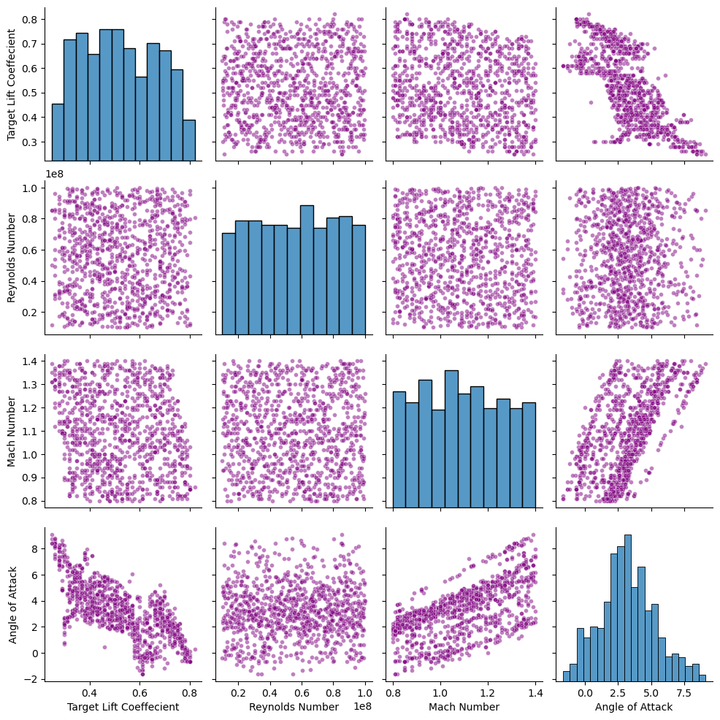
Data Visualization

Slide 6
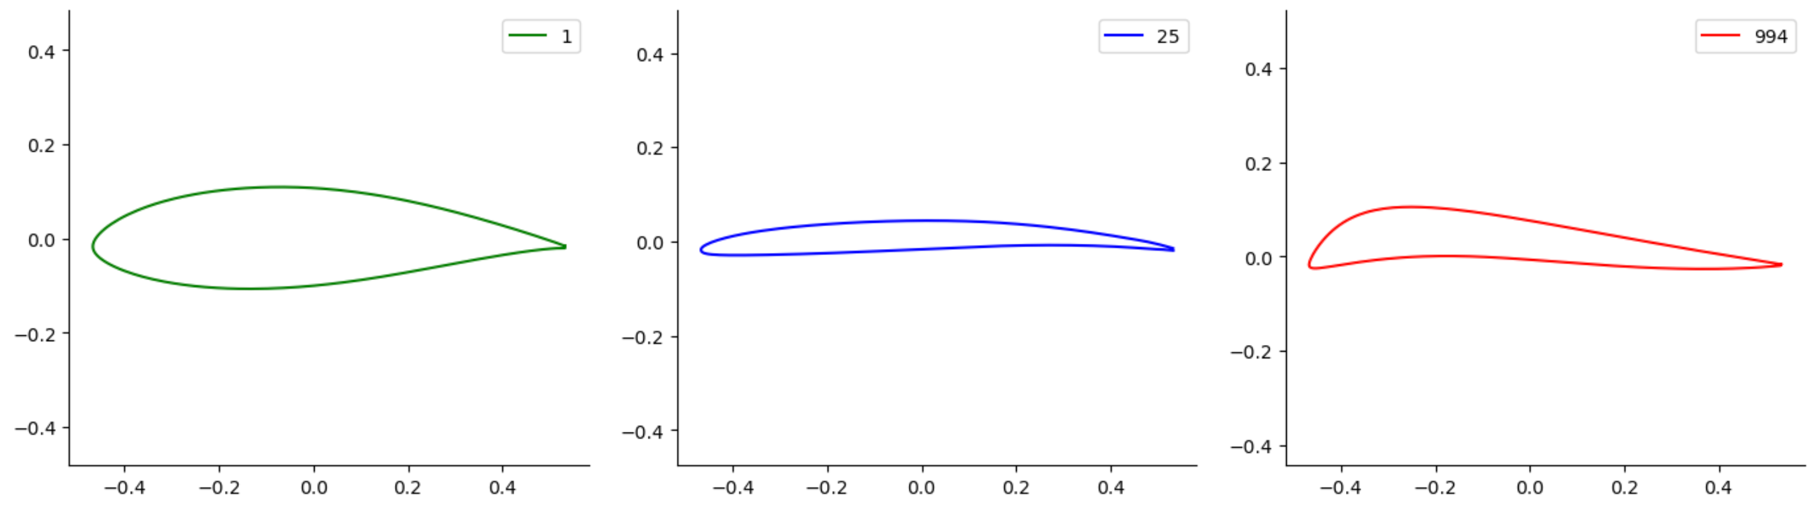
Data Visualization

